Slide 1
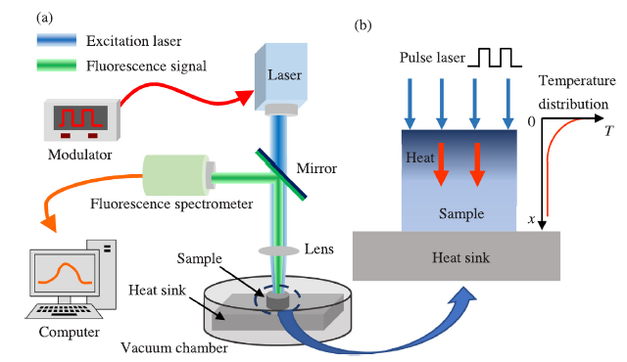
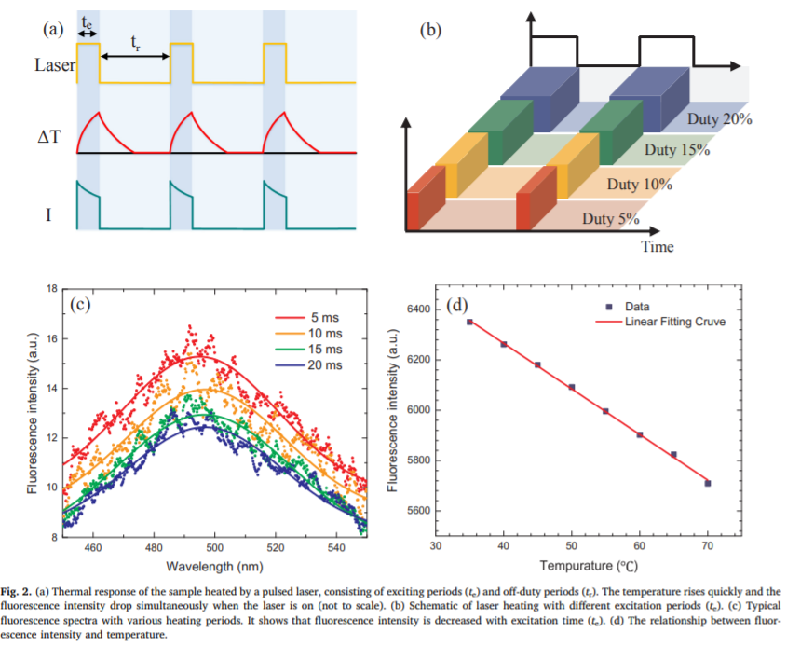
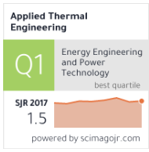
Scope of the study A time-domain fluorescence spectroscopy technique is developed to characterize thermophysical properties of polymers, using a continuous semiconductor laser (150 mW) with 405 nm wavelength is modulated with adjustable periodic heating and fluorescence excitation Samples Samples PVC Process and Findings The sample is heated and excited by multiple laser pulses, the fluorescence signal is collected during the laser heating period, fluorescence signal is temperature dependent. Thermal diffusivity of PVC obtained with this study was compared with the reported values characterized by laser flash technique and hot wire technique. Application The successful measurement of PVC proves that this time-domain transient fluorescence method can be well applied to polymers Compared with conventional methods, this new technique is much simpler by employing a single laser
Time-domain transient fluorescence spectroscopy for thermal characterization of polymers
*All the images and information have been taken from the original paper for scholar purposes.

